Slide 1
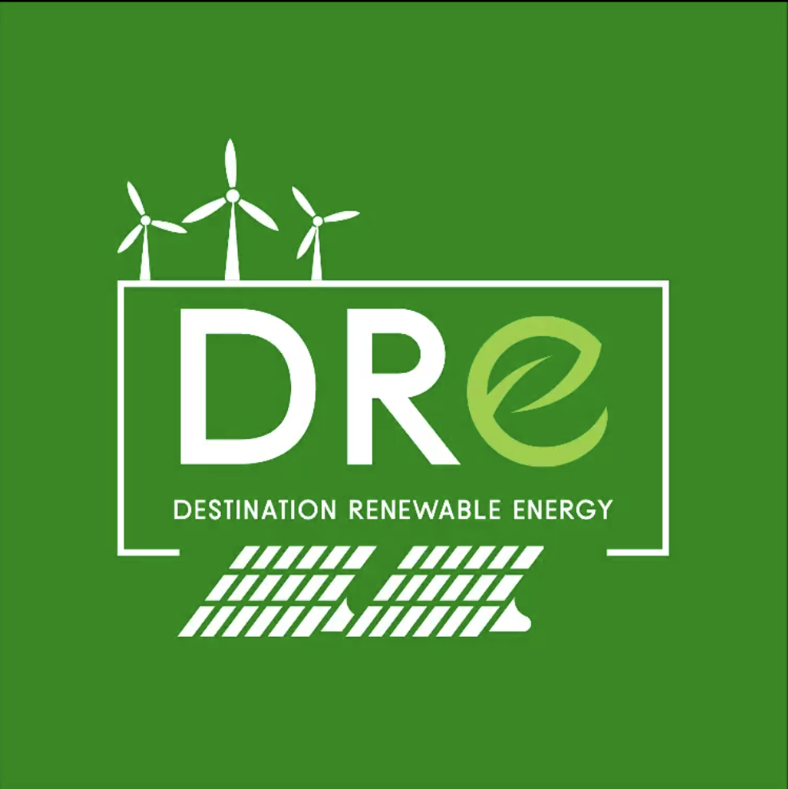
DRE Use Case
Introduction

Slide 2
Overview of the Use Case
A fully functional use case of DestinE for wind and solar energy forecasting from now up to two days ahead with high-temporal detail.
Builds upon two operational solutions developed and demonstrated in past EU-funded projects focusing on renewable energy and the energy market.
Provides a decision-making tool for alternative uses, energy storage and trading opportunities based on the availability of renewable energy from wind and solar resources.
Uses data from the DestinE Data Lake, including the Cams Solar Radiation Time Series, ERA5 hourly data on single levels, and the Weather-induced extremes Digital Twin.
Built to be flexible and scalable, based on real user needs.

Slide 3
Relevance to the DestinE initiative
Key requirements:
Accurate forecasting is essential to support the global transition to sustainable energy systems by making renewable energy more reliable and feasible.
Developing standardized forecasting models and protocols can facilitate international collaboration and knowledge sharing.
A flexible forecasting methodology, adaptable to different geographical regions and climates, supports the global deployment of renewable energy projects.
The unified DestinE platform capabilities and high-quality global data provide an excellent opportunity to use data and resources previously used sporadically and in a fragmented way. Accurate, real-time and state-of-the-art datasets and data pools available on DestinE, significantly enhance the forecasting accuracy for both solar and wind technologies.

Slide 4
Key outcomes
The transition to clean energy (2030 Agenda for Sustainable Development, Paris Agreement on climate change) is challenged by the dependency of renewable energy systems (solar and wind) on climate and weather.
To tackle this challenge, accurate climate information on solar and wind availability in different spatial scales is essential. This information can be provided by climate services and satellite-based earth observation platforms, which can be used to develop applications that enhance the resilience of energy systems to climate-related shocks and maximize their efficiency.
The DRE Use Case developed the Hybrid Renewable Energy Forecasting System (HYREF), a hybrid (solar and wind) application that provides renewable energy forecasts in different time scales by utilising the capabilities of the DestinE platform, part of the Destination Earth initiative.

Slide 5
Key outcomes
The DRE Use Case is expected to:
Demonstrate and harness the value and potential of DestinE for accurate and reliable energy forecasting services.
Empower policymakers and decision-makers with crucial insights for informed energy trade strategies, enhanced energy security, and optimized resource allocation.
Support the EU Green Deal Supporting initiatives, such as the promotion of renewable energy outlined in DIRECTIVE (EU) 2018/2001, and the REPowerEU Plan.
Contribute significantly to achieving the goals outlined in both the 2030 Agenda for Sustainable Development* and the Paris Agreement on climate change.

Slide 6
DRE Use Case
Introduction

